Slide 1




SUBABUL
Seed deployment - potential
Subabul Planting Propagules
Yield potential
Strategies for subabul productivity
2%
Hyco seedlings
95%
Direct seeds
Promoting clonal plantations
Seeds on par with clones
3%
Clones
Potential WY @ 3 Yrs. (MT / ac)
C16
C146
ITC 2553
ITC 2554
ITC 2555
Seeds from unknown
Seeds from K8
Seeds from Clones
Lack of uniformity
Poor survival due to inbreeding depression
Termination of genetic gain
Seeds:
biotic stress tolerant
Less expensive propagules
No lodging
Clones:
High yielding
Relatively Uniform

Slide 2
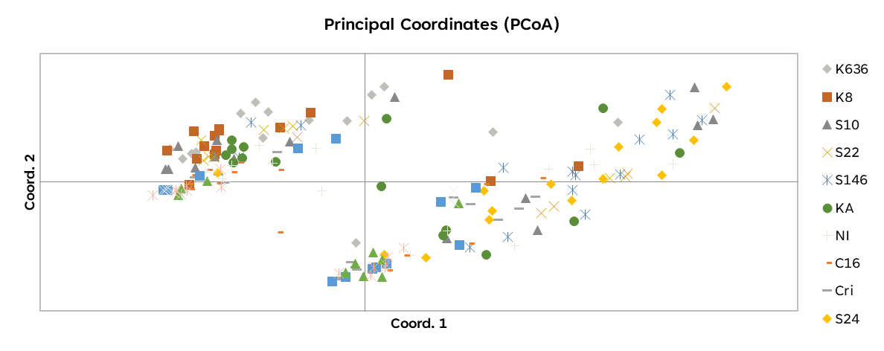
SUBABUL
Research plan for seed = clone
LEUCAENA
L. Leucocephala ssp. leucocephala.
L. Leucocephala ssp. glabra.
L. diversifolia
Original Hawaii collection
Crida colectios
Short
Bushy
high seeding
Tall
Straight
Poor seeding
Shy rooter
Superior WY
C 16
K 636
C 146
Identified two major genetic groups in Subabul
TIMELINE
2022
2023
2024-26
2025-27
2026-28
2028-30
In-house markers
developed
Genetic assessment
of existing material
completed
Evaluation of
existing families
/ Orchards &
Informed selection
Estimation of
outcrossing rate &
selection of parents
Phase I & II
Establish
New Orchards &
Informed selections
Progeny tests
Selections
&
Superior Seeds

Slide 3
CORYMBIA

