Slide 1
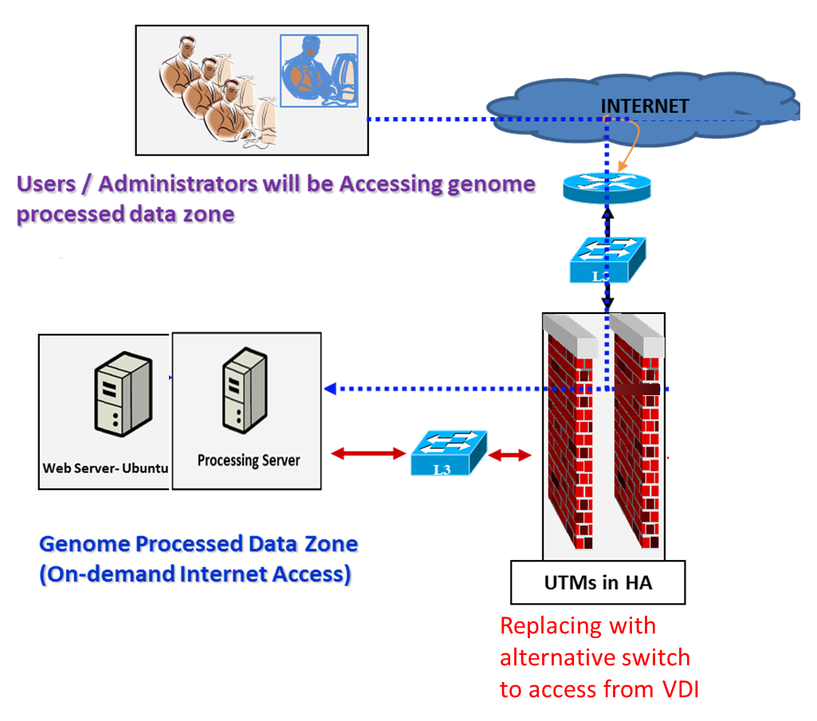
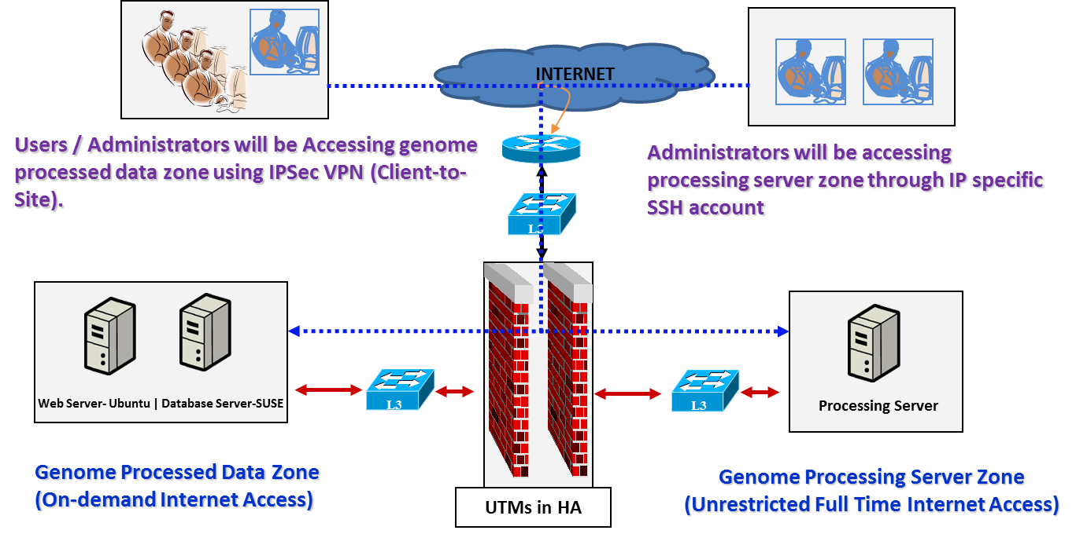
Genome Network – Deployed in 2014-15
Genome Network – Proposed Change
Advantages on Proposed Change
Cost effectiveness. The recurrent cost investment for the dedicated infra would be saved.
Seamless access within ITC LAN wit data security.
GPU powered server has an advantage for AI applications if it is in accessible from LAN.
The scaled-up analytical, Bioinformatics and data science projects can be accessible within ITC LAN for LSTC.
Limitations on internet: Initial setup and configuration of work environment shall be regularised through an administered practice for respective project / developer.

