Slide 1
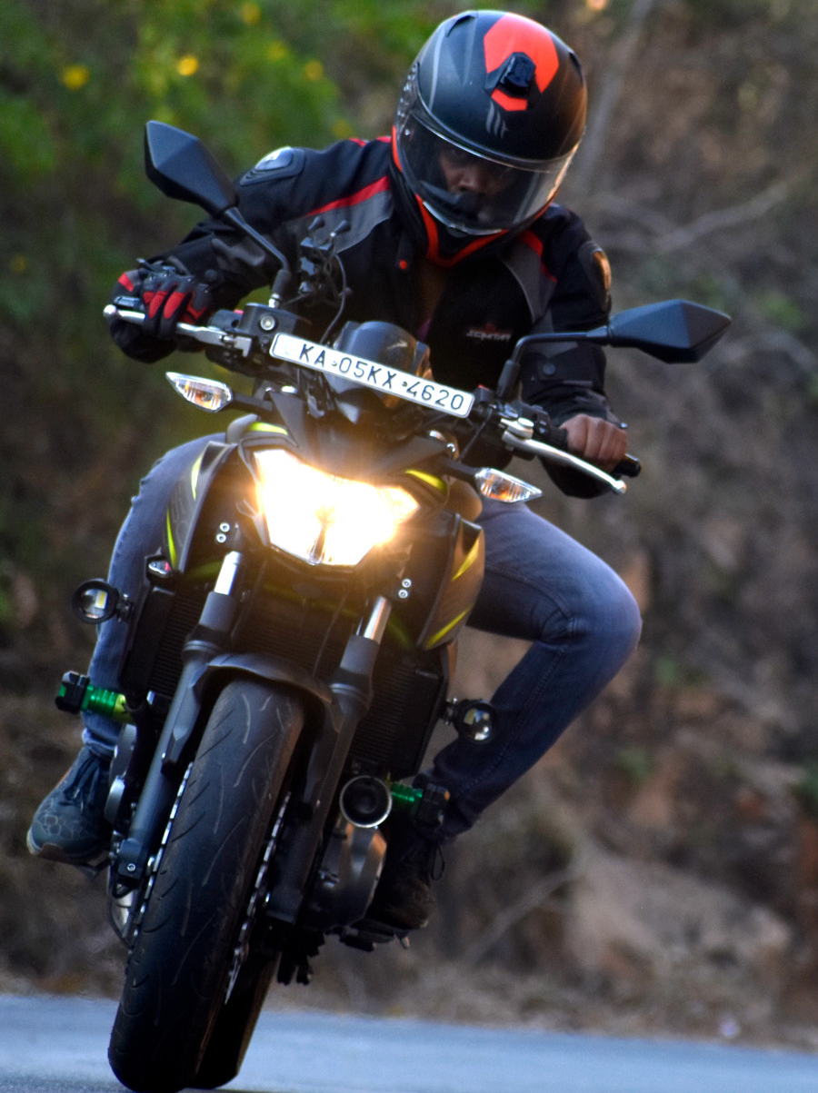
R.No: KA05 KX 4620 | KAWASAKI BIKE | Model: Z650

Slide 2
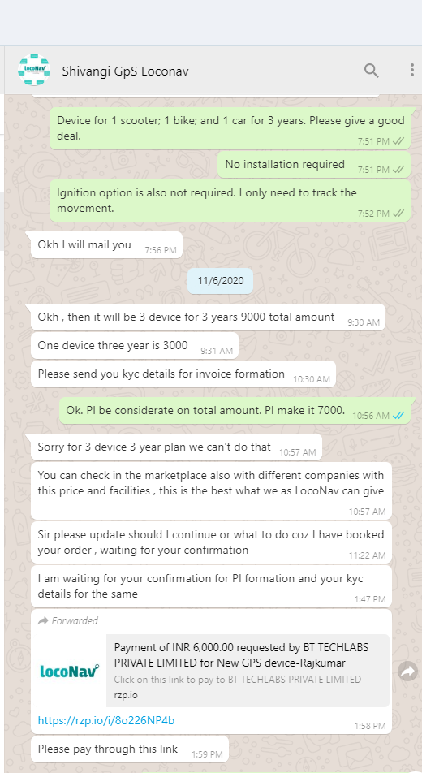
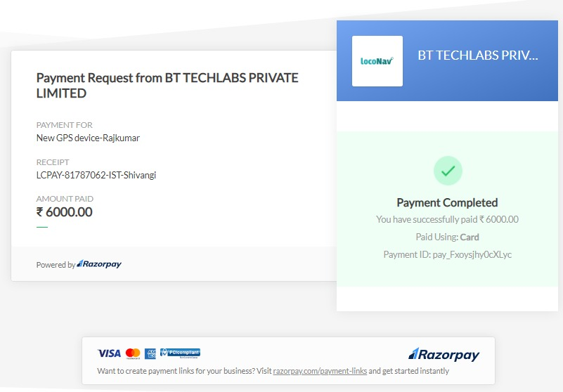
Rajkumar Rathinavelu
No 6116, Prestige Royale Gardens,Dodaballapur Road, Yelahanka, Bangalore 560 064
Email: r@rajkumar.in
Ph: 9164753973

Slide 3
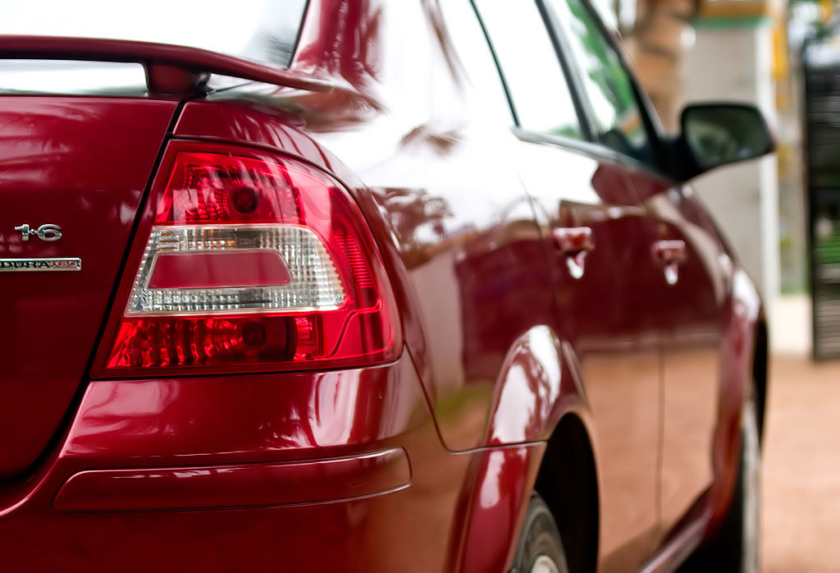
R.No: AP28DA2504 | FORD FIESTA

