Slide 1
PSPD
ANALYTICS

Slide 2

Current Projects (2023-25)
Bioinformatics
Technology development
# | Nick Name | OUTCOME / Metrics | Status
1 | TORO | Orabanche: Target markers in Nt genome for gene silencing / genome editing.
2 | Chemisthesis | Menthol alternatives (Thirst Quenchers)
3 | NIP | Compounds & biological mechanisms for enhanced nutritional and natural defense elicitors. (Inflamaging)
4 | SERM | Compounds: Potential SERM modulators insilico (IB)
5 | Senolytics | Cell senescence: Insilico methods for screening the compounds / ingredients. (Vital aging)
6 | Peptide modulation & prediction | High quality report with complete analyzed results (Antimicrobials)
7 | MaV | Rye alternative combinations for baked products
8 | HepI | Systems Biology analytics integrating Proteomics & Methylation dataset (Antipollution)
9 | Analytics Support | Explorative / Translation: Silvi / crop science / Bioscience analytics including Microbiome.
10 | Infra | Infrastructure management for Research analytics & IT operations
# | Nick Name | OUTCOME / Metrics | Status
1 | Gendrome | Redeploy the UIs in Webserver
2 | L-Sense | Digitization of Sensory application with visual dashboard
3 | ELN | Lab Notebook & Analytics platform Technical feasibility study
100%
10%
20%
100%
40%
20%
Data Science
10%
# | Nick Name | OUTCOME / Metrics | Status
1 | S. Modeling (ONA; Product ranges) | Seed orchard design
2 | Biomass and Clonal identification | UI with Biomass predictor and Clonal identifier
3 | Satellite Imaging for Wood dynamics | Scalability of Potential area identification
4 | Farm AI | Farm practices UI
6 | MLT-Twinning | Predictive performance in unknown location
7 | Disease risk mapping (CLB) | Risk management UI for plantations
8 | Anomaly Detection | Notification system
30%
90%
100%
10%
80%
75%
20%
10%
10%
90%
Continuous
Continuous

Slide 3
Problem Statement
Biomass
Recurrent process of ~> 100 employees measure plant biomass manually, (accuracy is questionable)

Slide 4

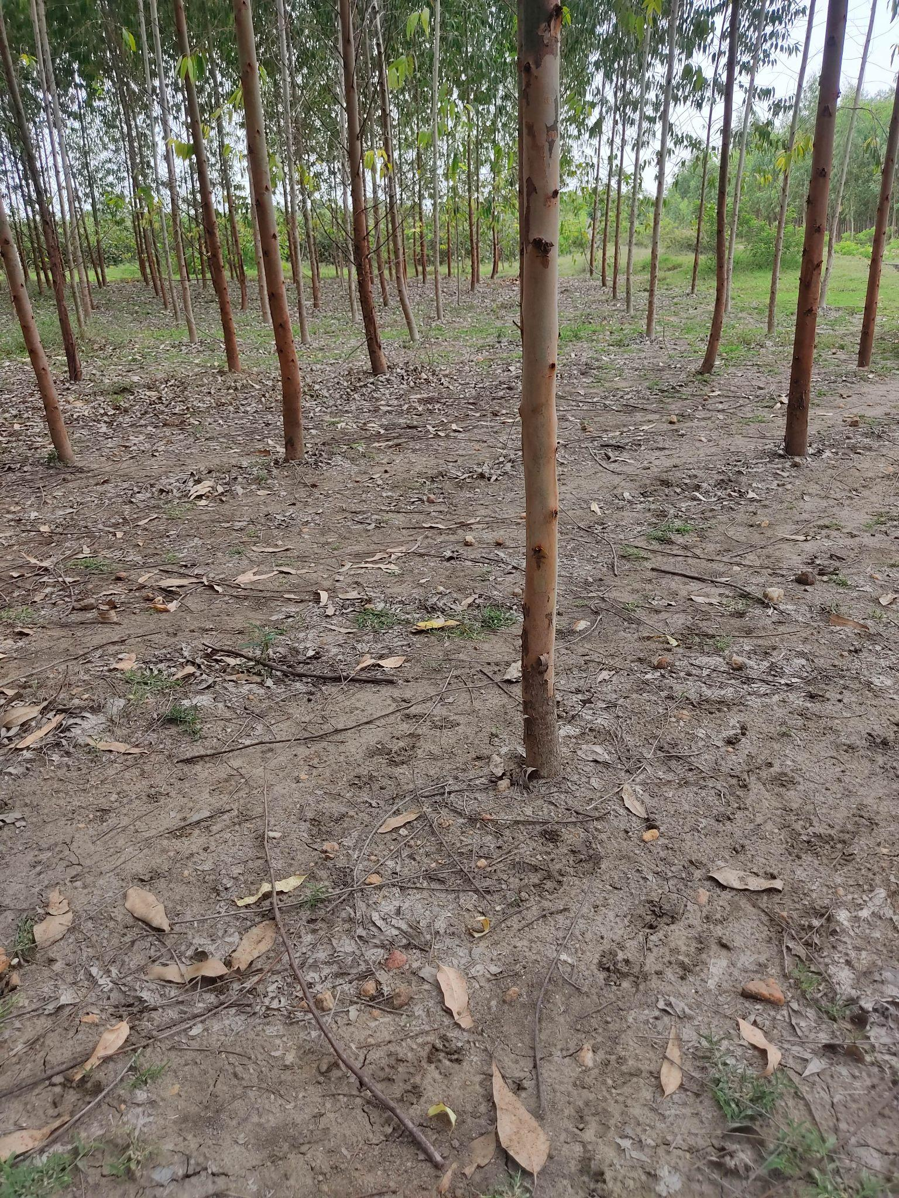
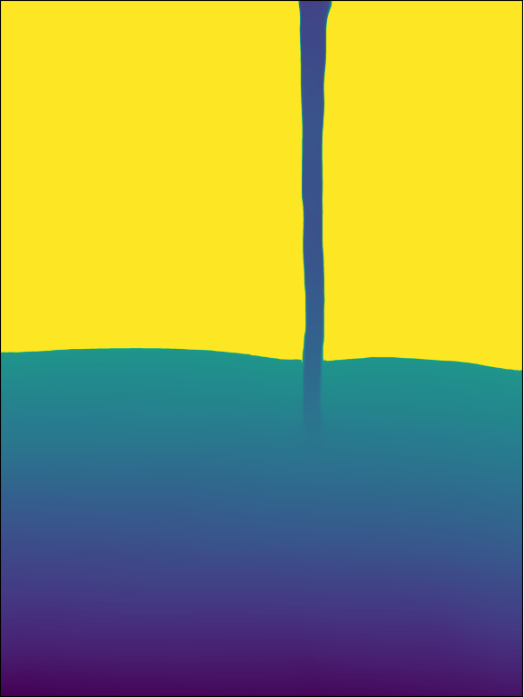
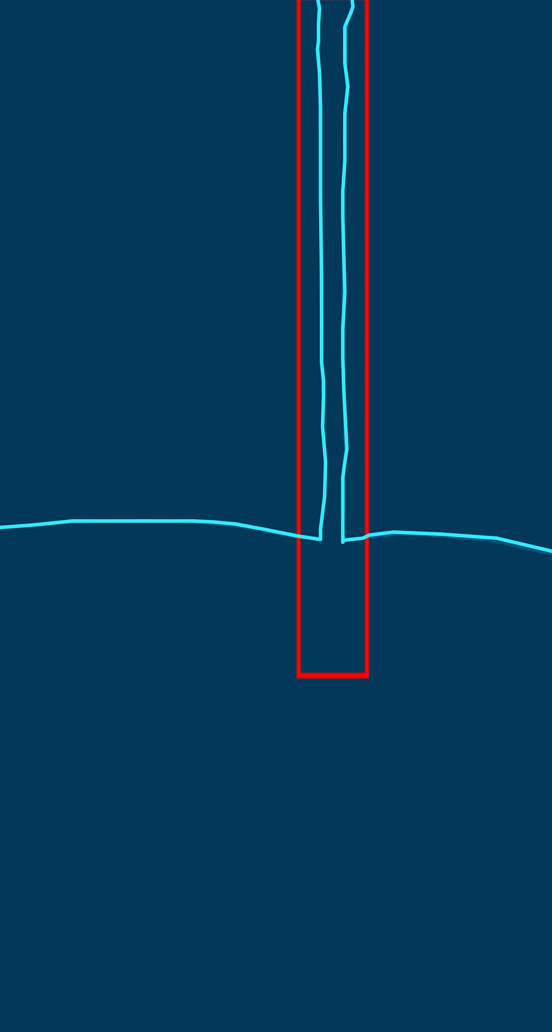
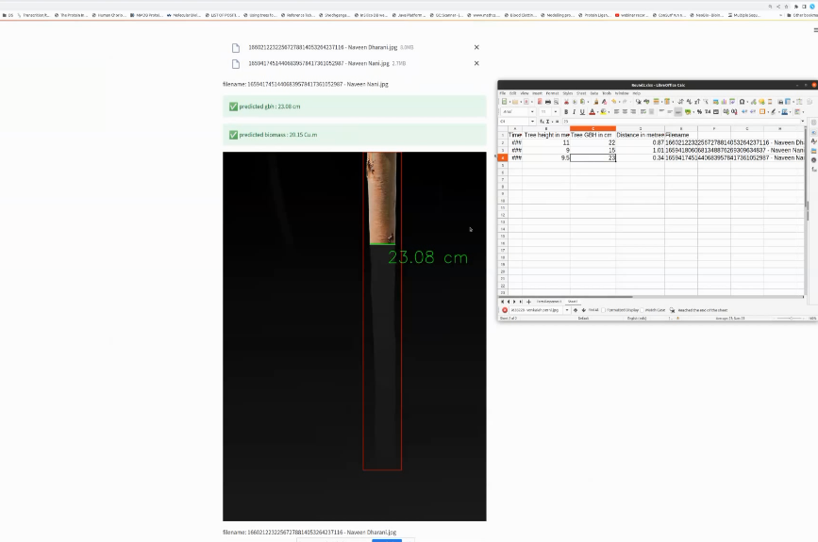

Model Pipeline
Biomass
Data Collection
Height of the Tree
Width of the plant spacing
Length of the plant spacing
GBH of the Tree
Laser based distance measurement
0.5 – 3 m
Model Architecture
Depth Estimation
Median depth score
Width of the trunk
Height of the trunk
Ray optics method
GBH
Object Detection
Ensemble learning
Deployment
Tree GBH estimation
Field Biomass estimation
Overall biomass $\left(Tons/acre\right)$
Backend Prediction
Sample Images
Application

Slide 5
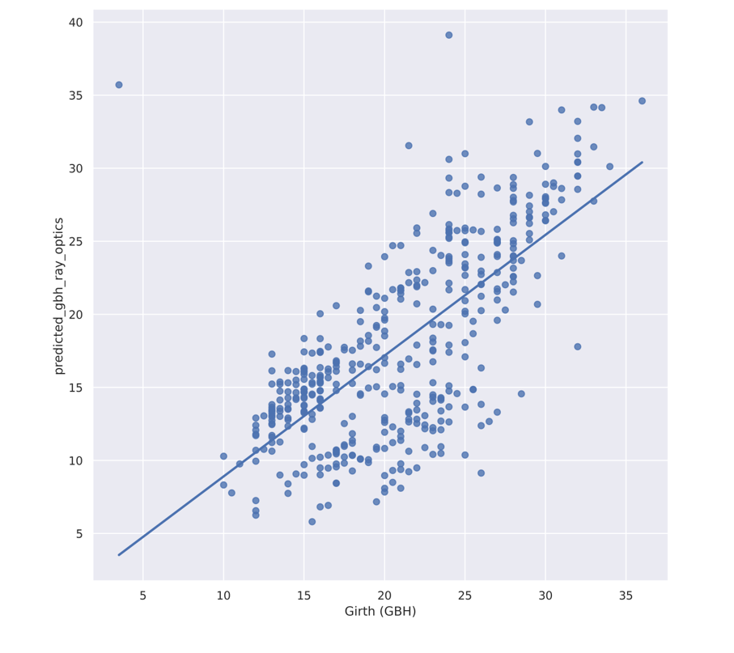
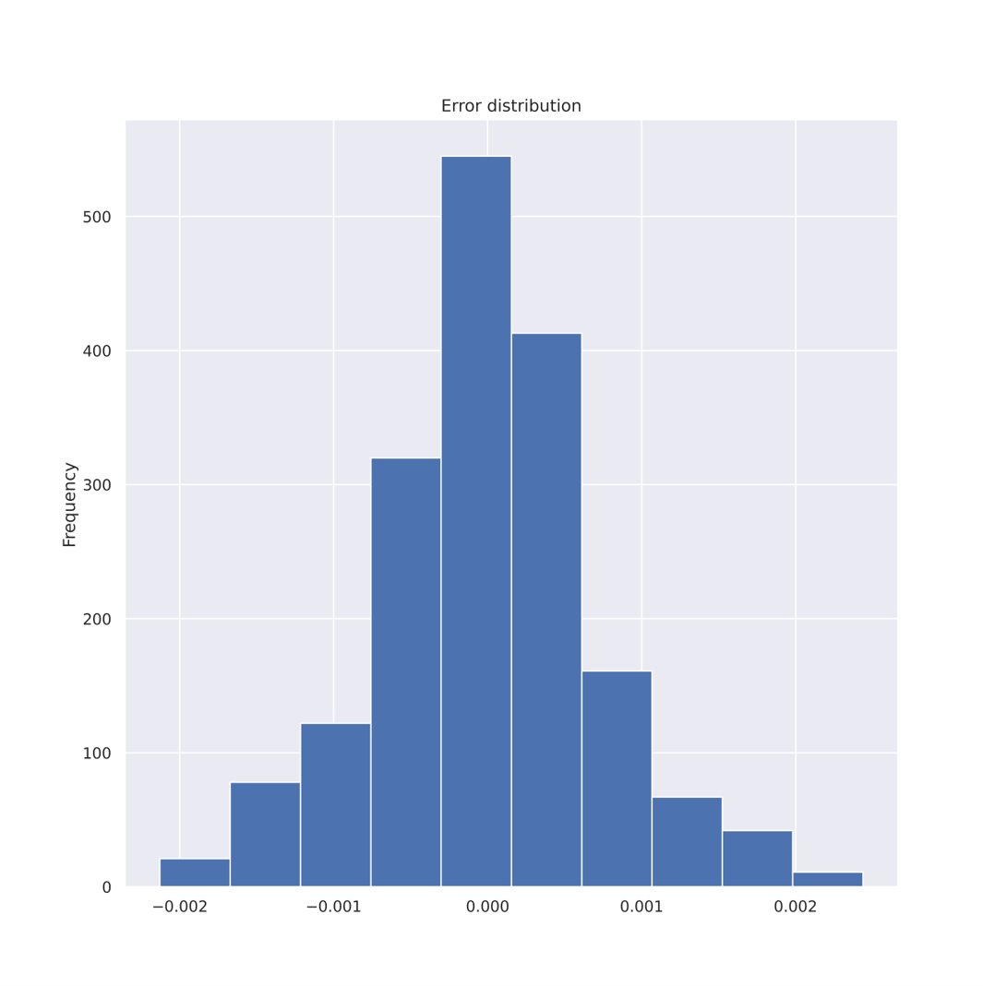
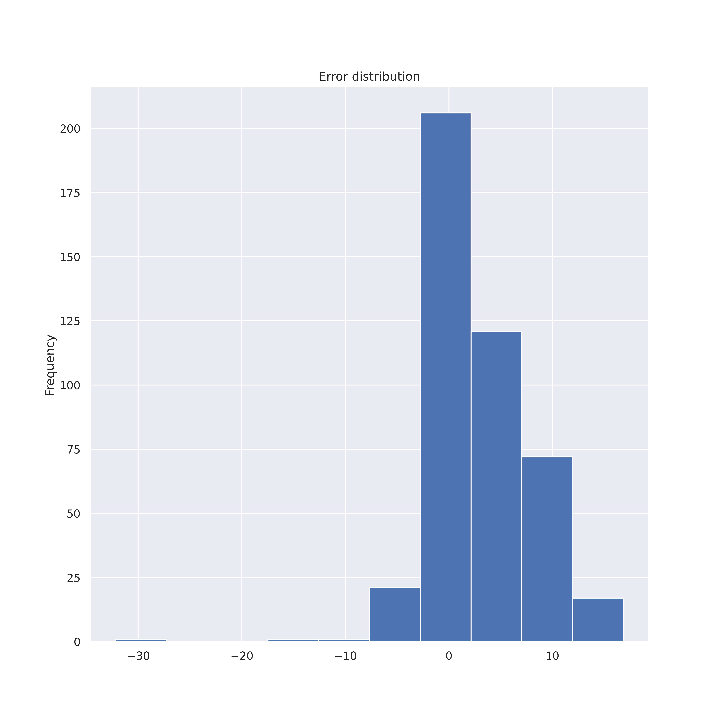
Results
Biomass
Ensemble
Ray Optics model
The strong correlation of Ensemble approach with squared R of 99.99 and dense diagonal distribution shows model effectiveness in regressing the actual GBH.
Scatterplot of visual relationship between actual distance (cm) and predicted GBH (cm) obtained from ensemble approach (a) and ray optics approach (b).

Slide 6
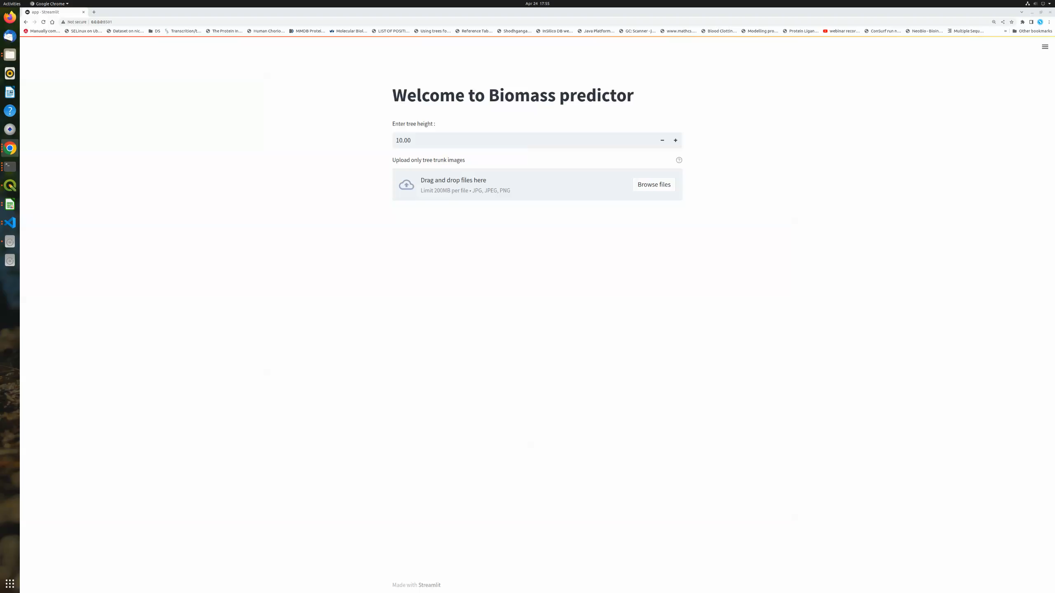
Current Status
Biomass
Biomass PREDICTOR
SDK is dockerized and submitted to i3L
Useful for wood survey
LSTC: Hand Hold for deployment issue if any

Slide 7
SI

Slide 8
PROBLEM
STATEMENT
The Scale
> ITC covers 1.16 million acres
>11 lakh farmers covering 3 states (extending)
~ 6000 tons of wood harvested PER DAY (PSPD)
Manual Efforts on
Plantation assessment & enumeration
Carbon sequestration estimates
Auditing

Slide 9
PROBLEM
STATEMENT
# | CURRENT PRACTICS | REQUIREMENT
1 | Manual assessment of multi-species | Automation
2 | Manual recommendation of farm practices | Automation
3 | Manual trouble shooting of plant growth | Automation
4 | Area expansion (Manual search of species specific potential area) | Potential area identification

Slide 10
SOLUTION
Plant feature engineering for potential area
POTENTIAL IMPACT @ POC level
<1^{Cr}
1-5^{Cr}
5-10^{Cr}
10-50^{Cr}
<100^{Cr}
Assessment, Enumeration, sequestration
Potential area
Identification
Recommendation
Engine
Satellite imaging
Recommendation
Engine
Tangible
Intangible (scale - NA)

Slide 11
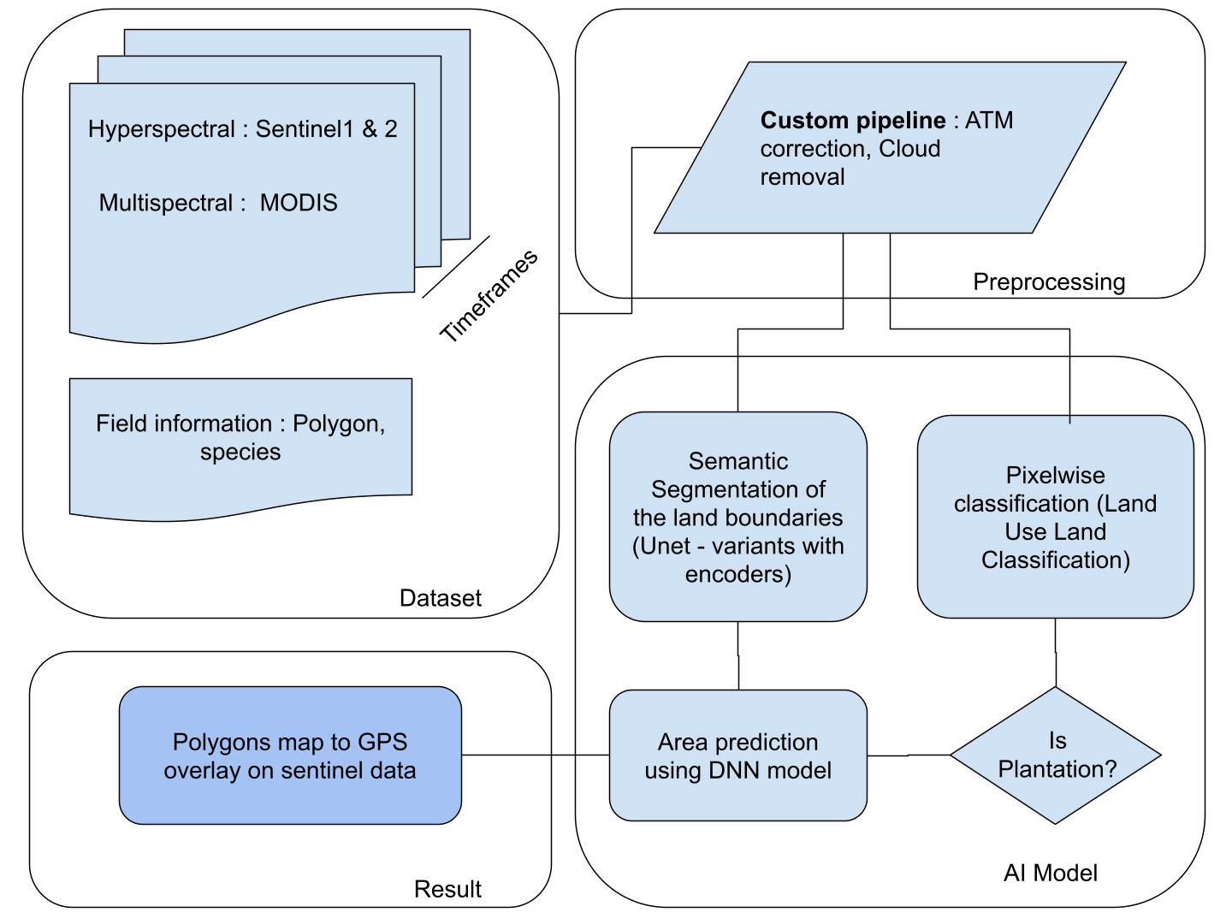

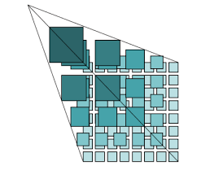
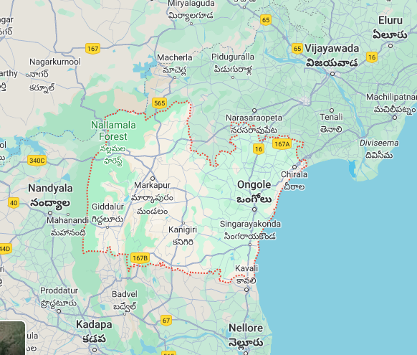
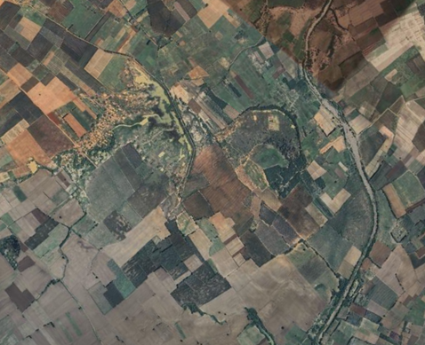
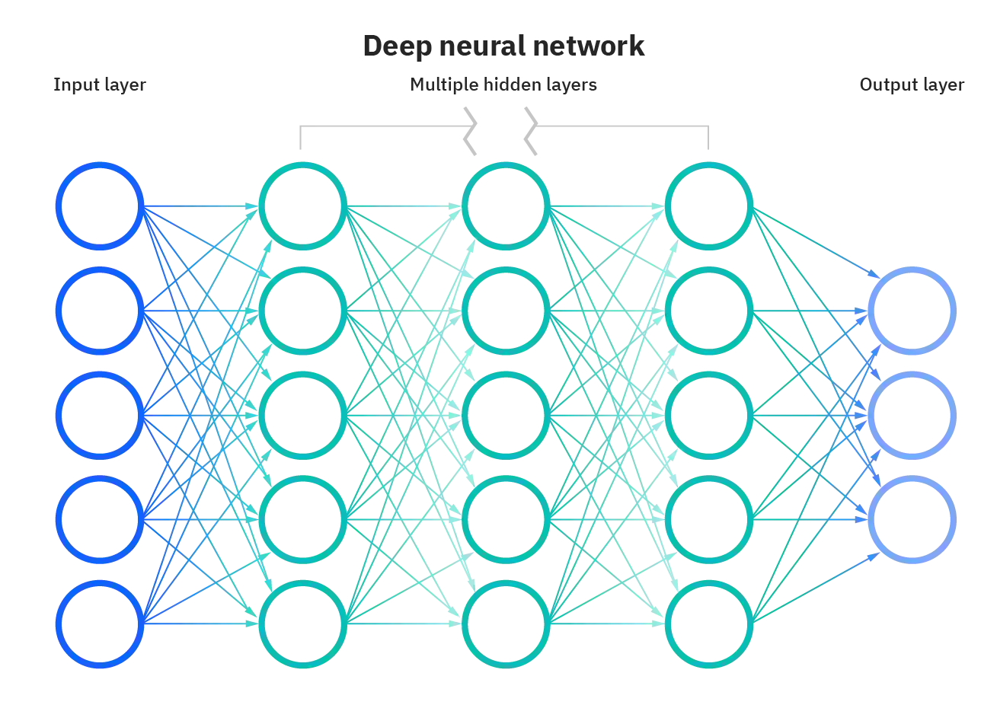
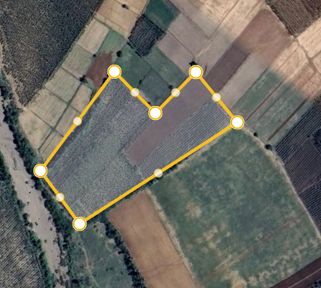
SO FAR..
S. Imaging Process
Satellite Image
Modified
CNN*
Prakasm Dt
Re-training
Training data
Interventions at preprocessing & deep neural network model

Slide 12

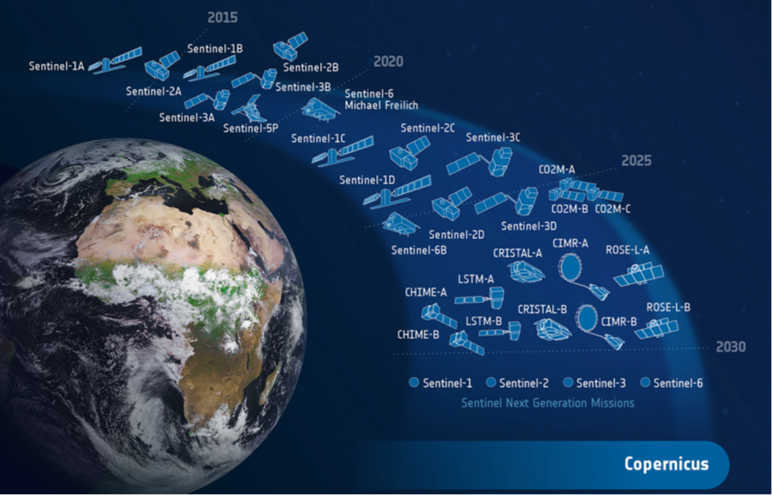
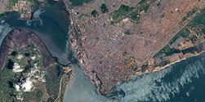

Satellite Imaging for commercial use
LEGAL, FEASIBIITY, PRECISION
DATA SOURCE
RAW Image
Preprocessed
FREE
Requires preprocessing & curation
Sentinel 1, 2, 3, Xe, etc
Copernicus Commercial subscription
Private Vendors Commercial subscription
COPERNICUS
European Geosciences Union
₹₹
₹₹₹
Data for one state might cost ~ 1.34Cr

Slide 13
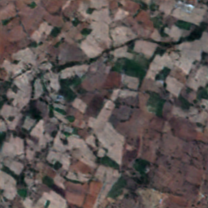
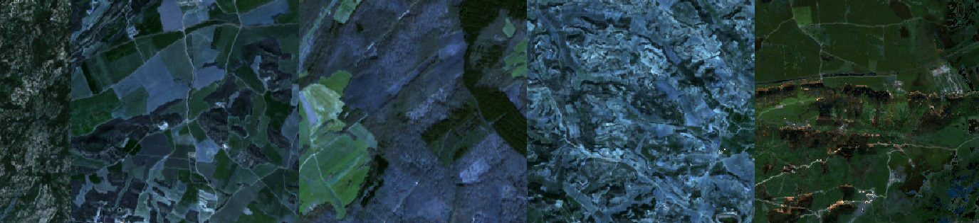

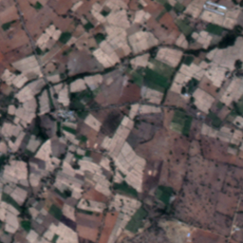
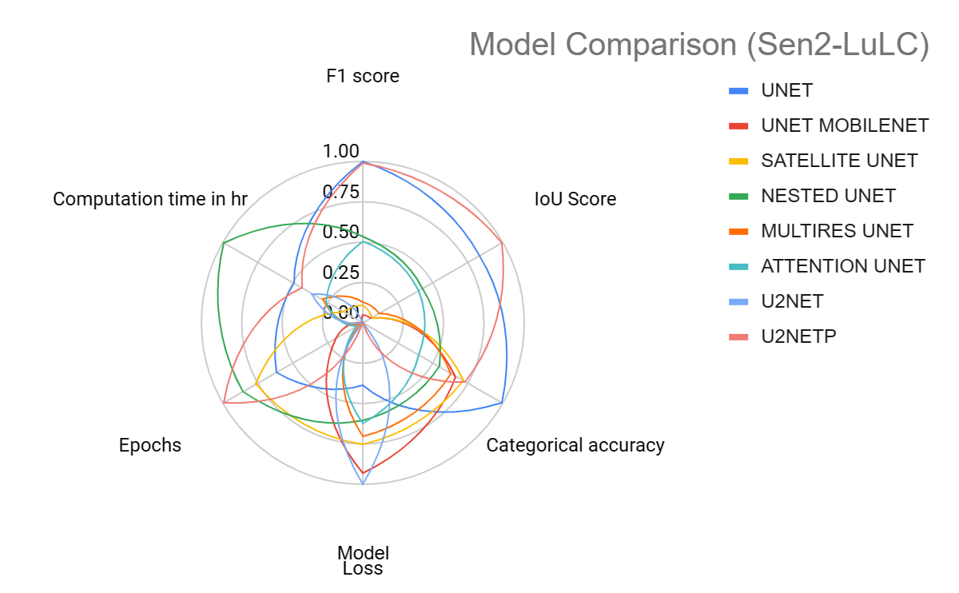
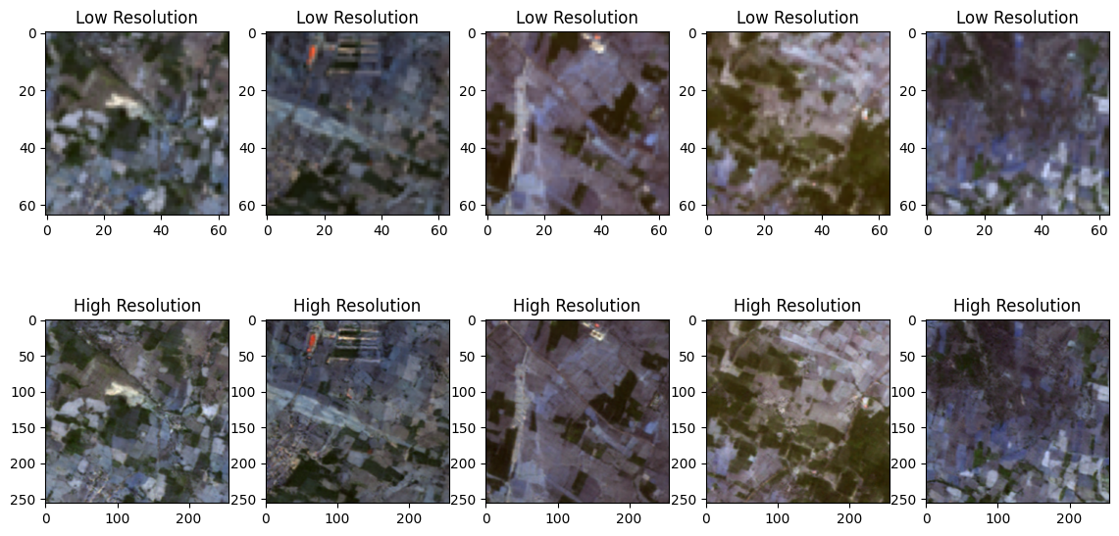

A NEW WAY
Super resolution
Field delineation
Sentinel (20 *20 m)
Modified ESRGAN
Venus (5 * 5 m)
Generated image (5 * 5 m)
On AI4Boundaries
UnetP
Europe

Slide 14
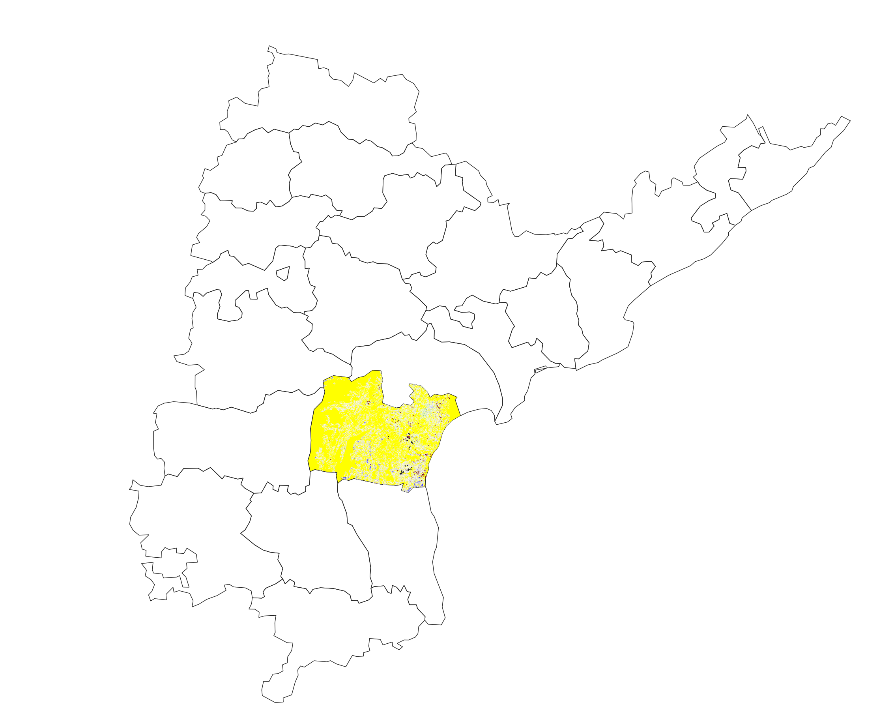
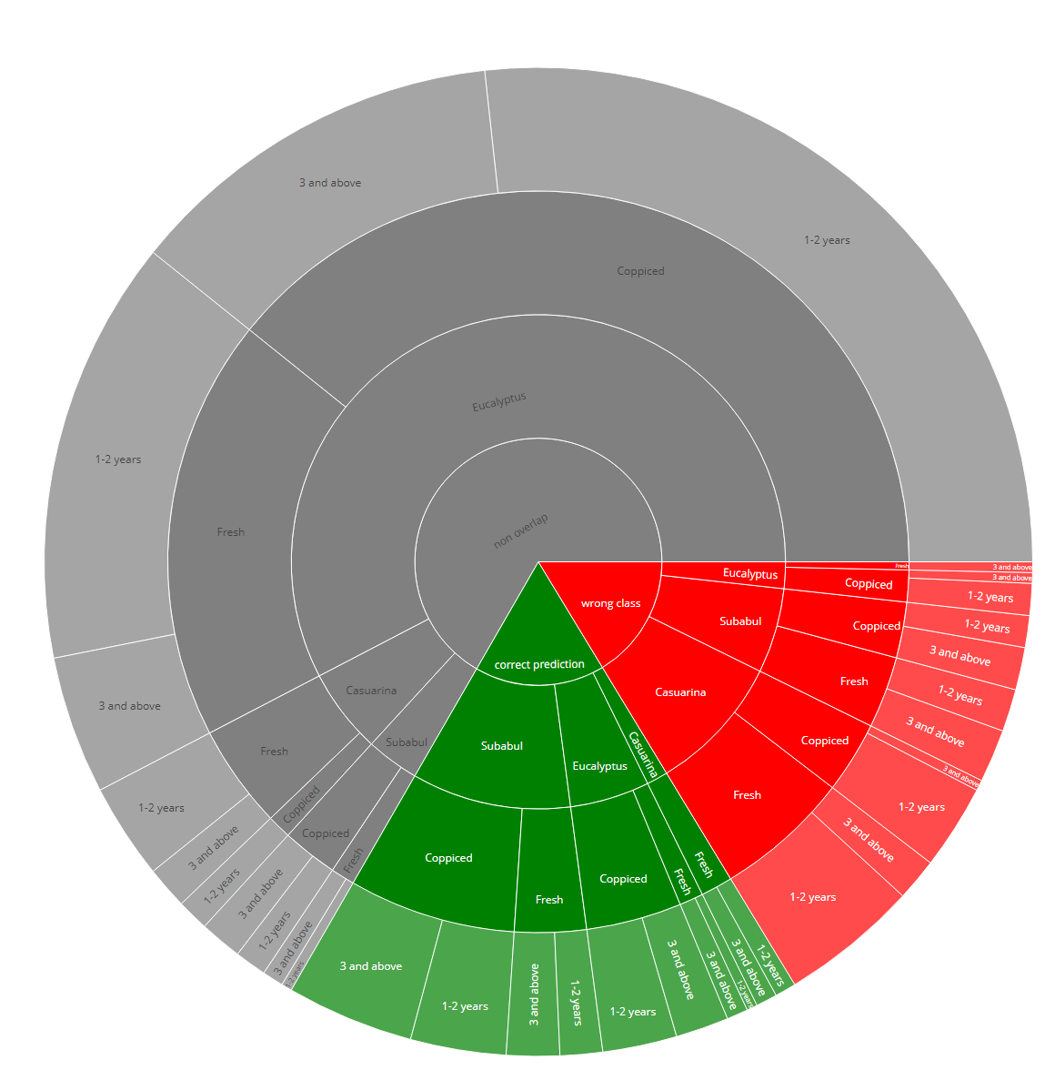
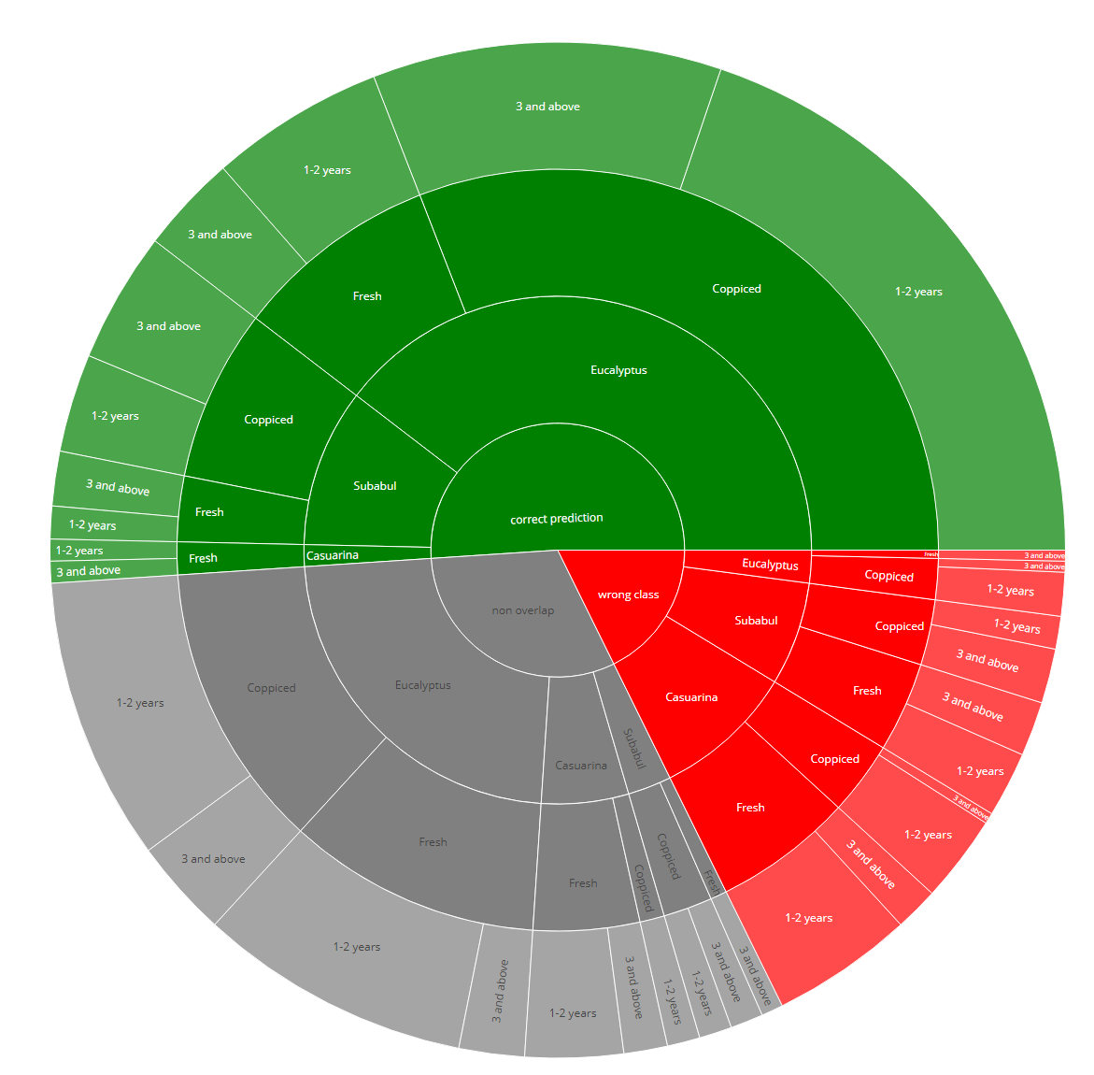
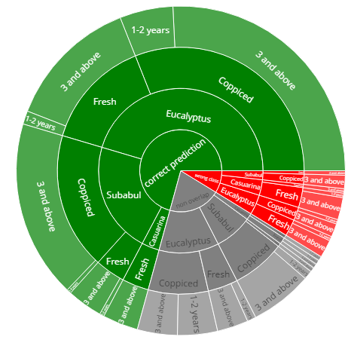
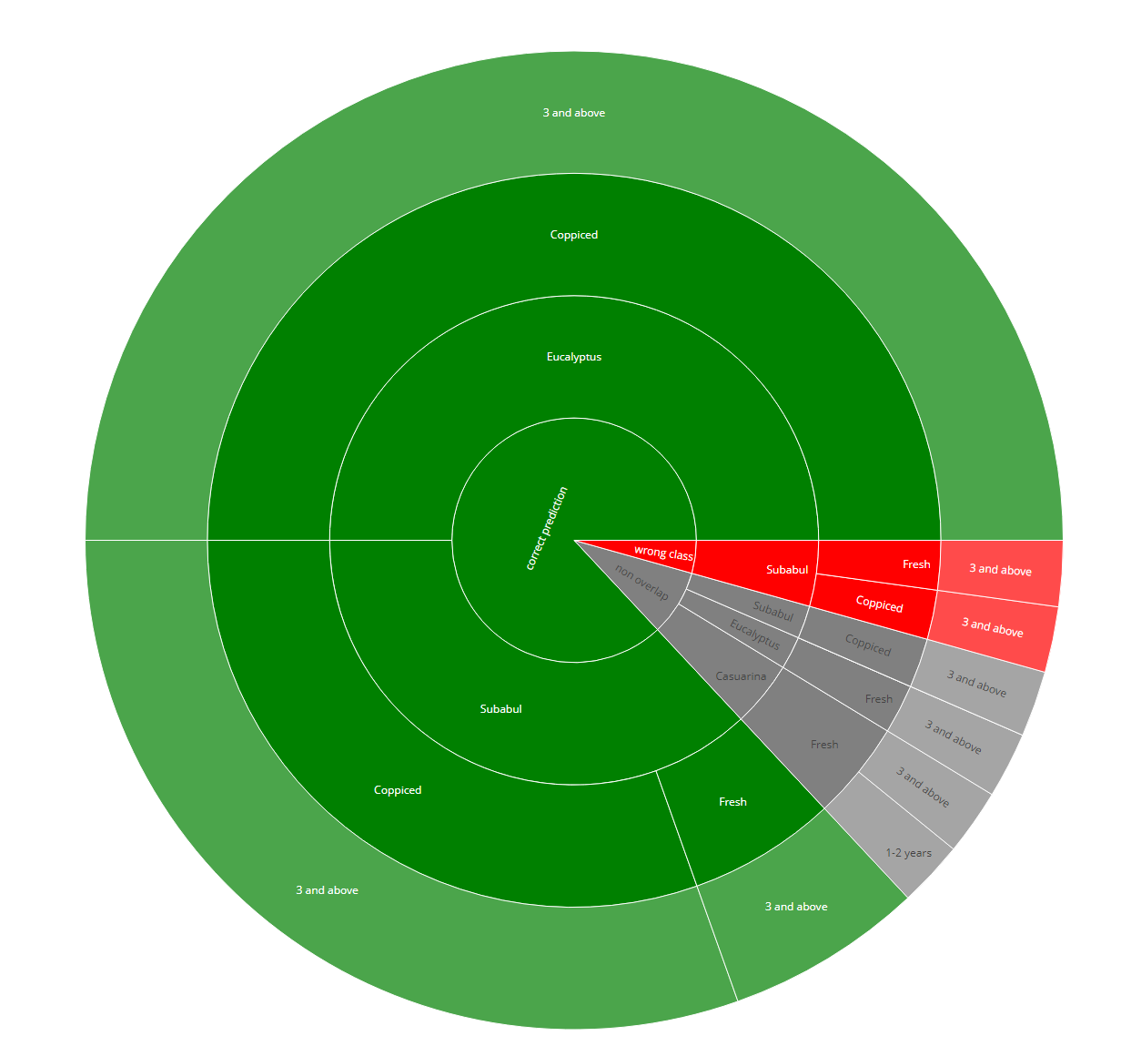
Prakasm Dt
Accuracy of modeling
30% Predicted
51% Predicted
74% Predicted
~91.5% Predicted
~17,622 Km²
^{~ 43 Lakh acres}
^{~ 16.56 Lakh cultivable land}
1st ITERATION
2nd ITERATION
3rd ITERATION
4th ITERATION
Only 50 data points were added to validation model

Slide 15
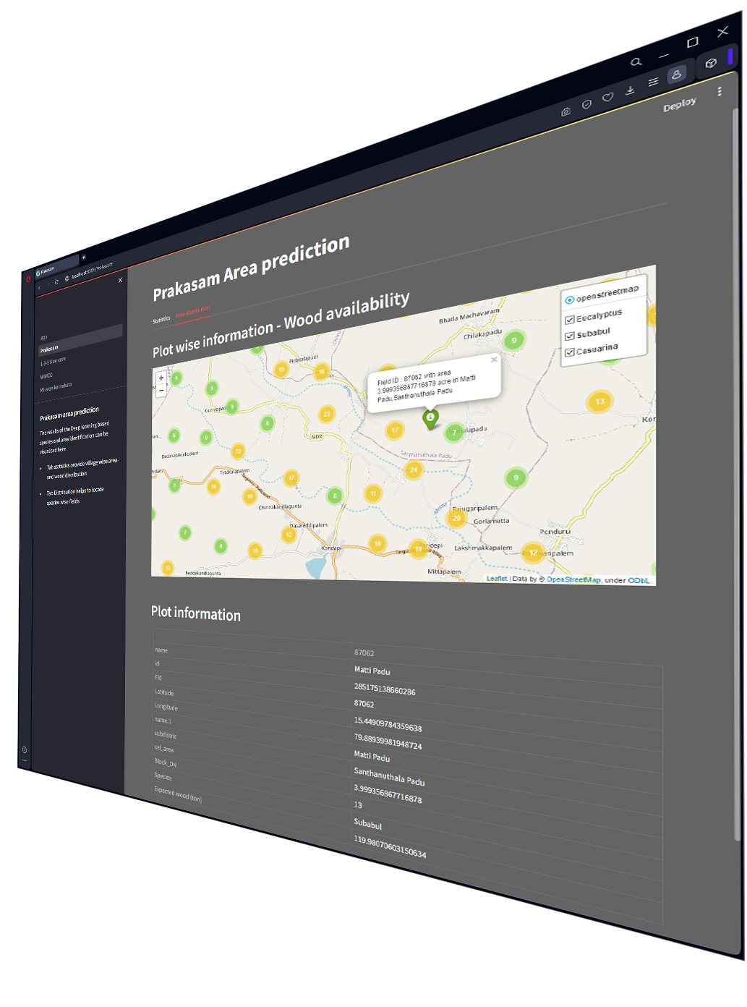
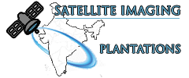
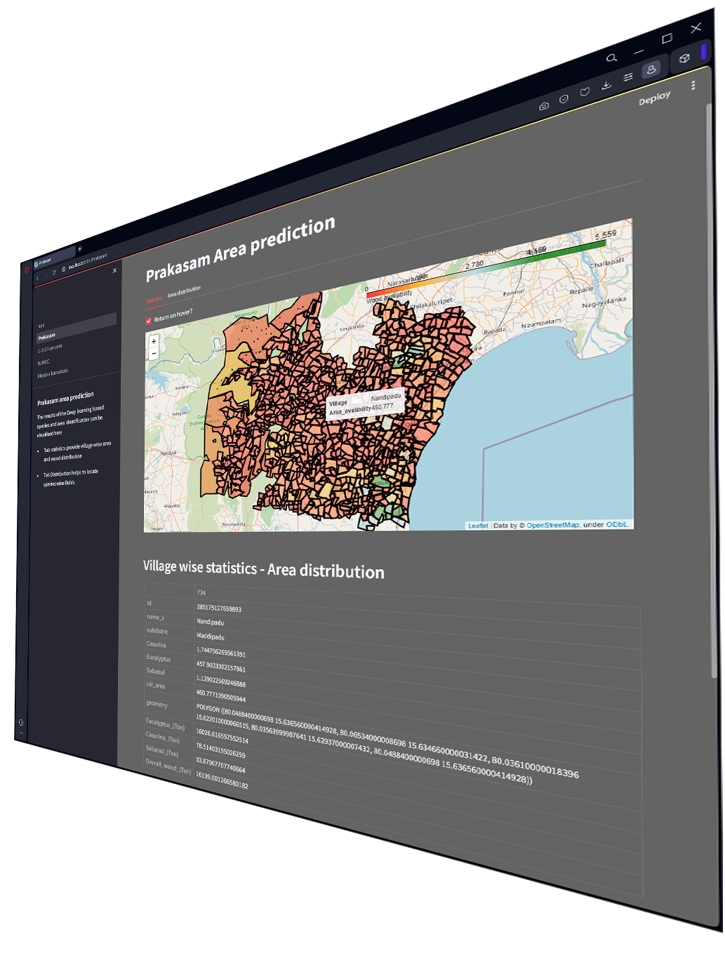

PRAKASM Dt OUTCOME
How to USE / Visualize ?
http://si.pspd.in

Slide 16
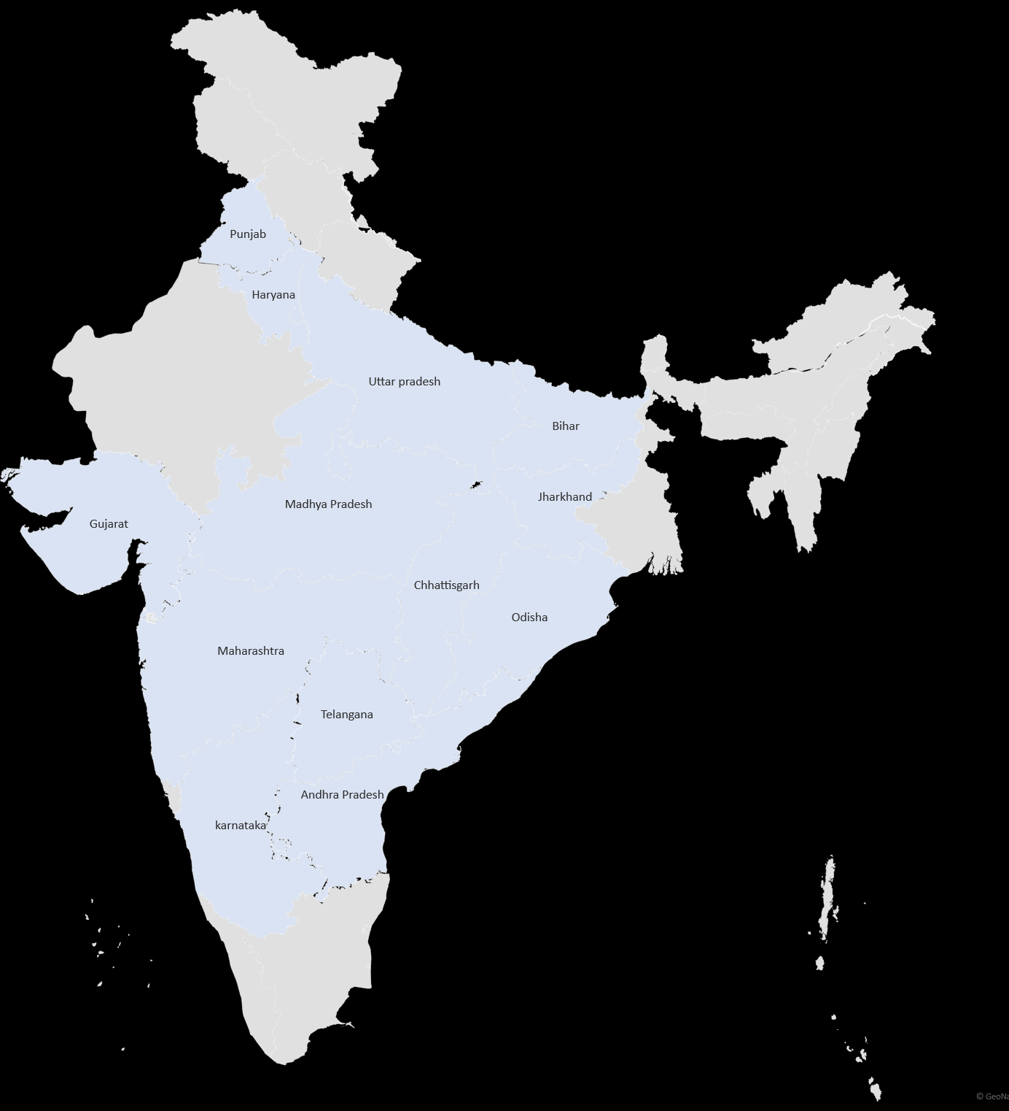
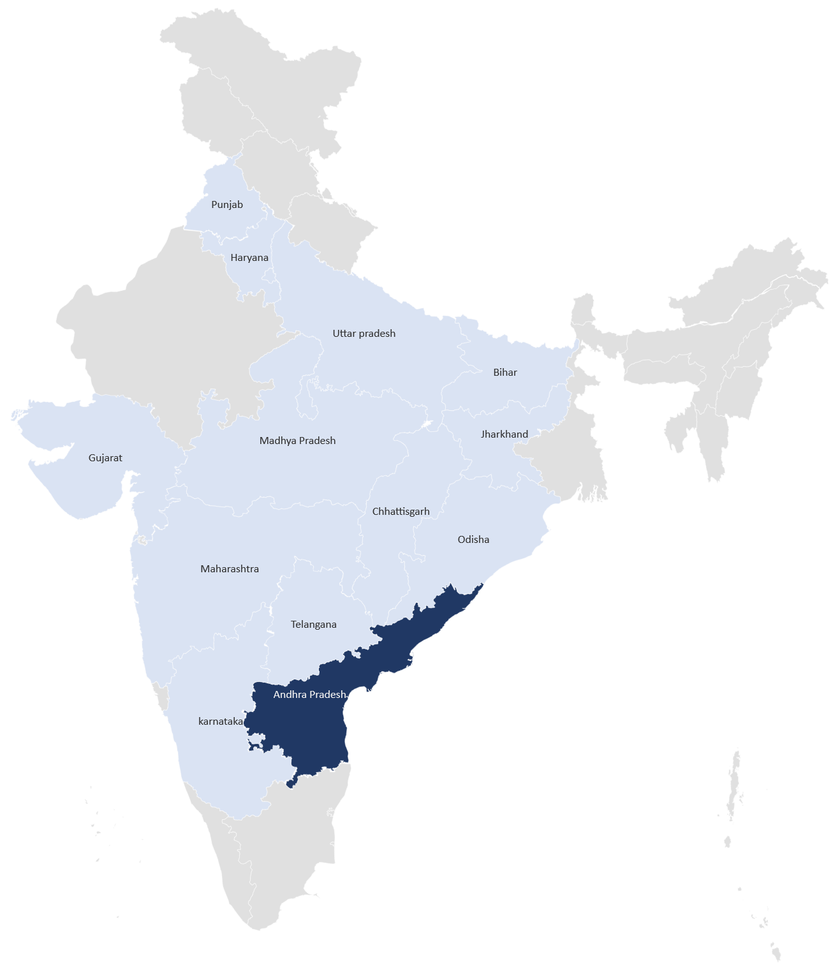
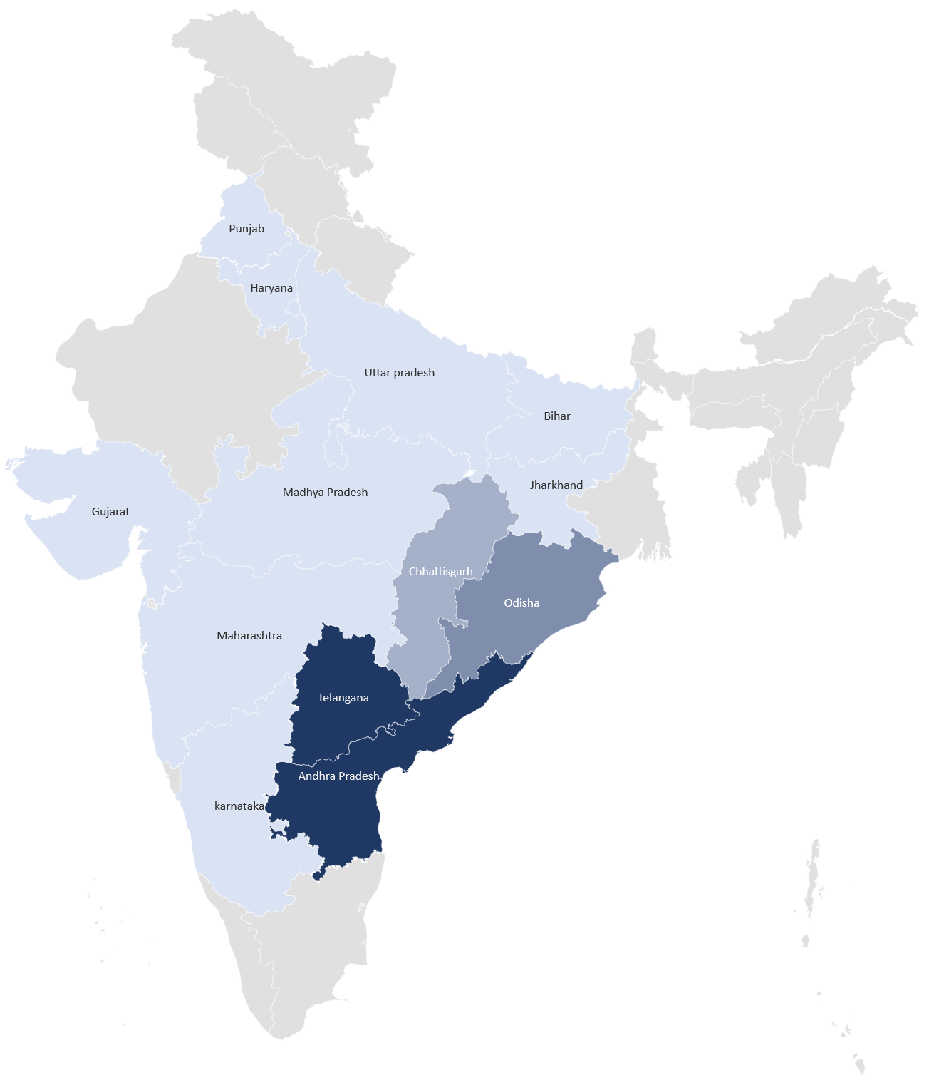
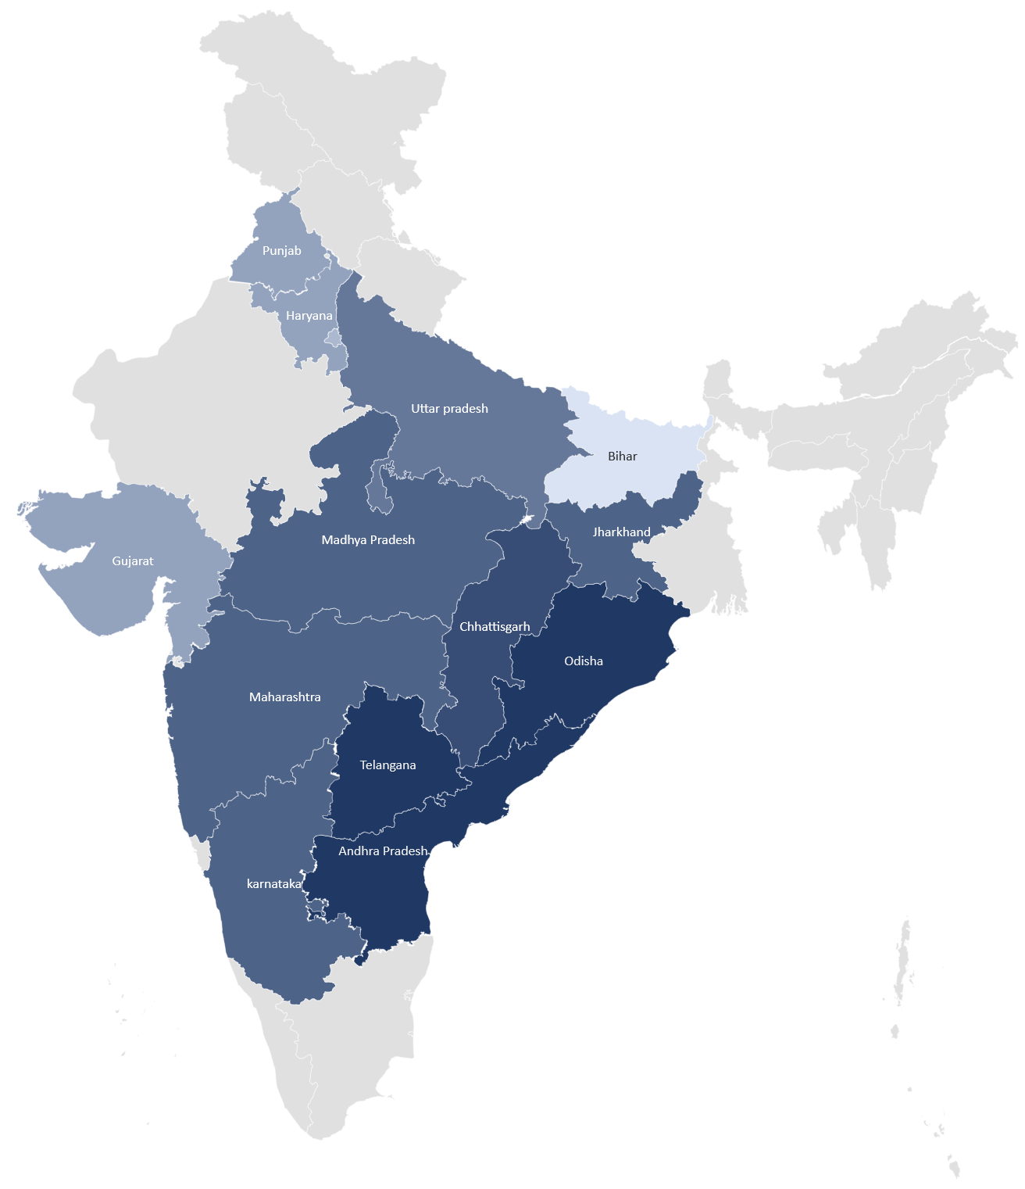
SCALE UP
Project ID: DIGIT101
Objective: Satellite imaging of Prakasm Dt (~17000 sq.Km)
P. Metrics: Species / Area identification
Business scale up pipeline to multiple states
‘23-Q1
‘23-Q2
‘23-Q4
‘24-Q1
POC of BCM (10 sq.Km)
Sampling Ground truth Data
Multi-species model built
A Road Map was built & presented in CMC
Scale up process with SatSure (4 mandals)
POC with 4 mandals
75% accuracy with Euca
~3% accuracy with Age
Super resolution
Field delineation
Completed by 2023
Completed by 2023-24
Business Cost saving : 12 Lakhs
Project ID: DIGIT104
Objective: Satellite imaging of AP / TS / Odi
P. Metrics: Species / Age / Area identification
Time Line: 2024-25
Business Cost saving: ~1.1 crores per scan.

