Slide 1
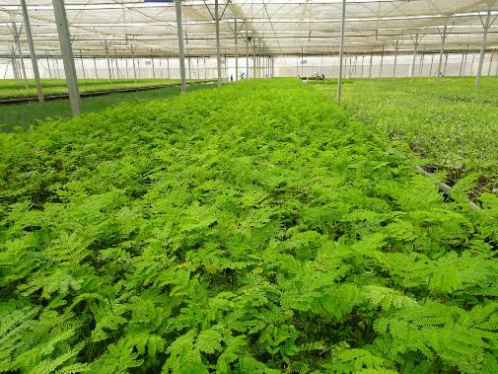
Please see if you can use this photo to design back cover

Slide 2
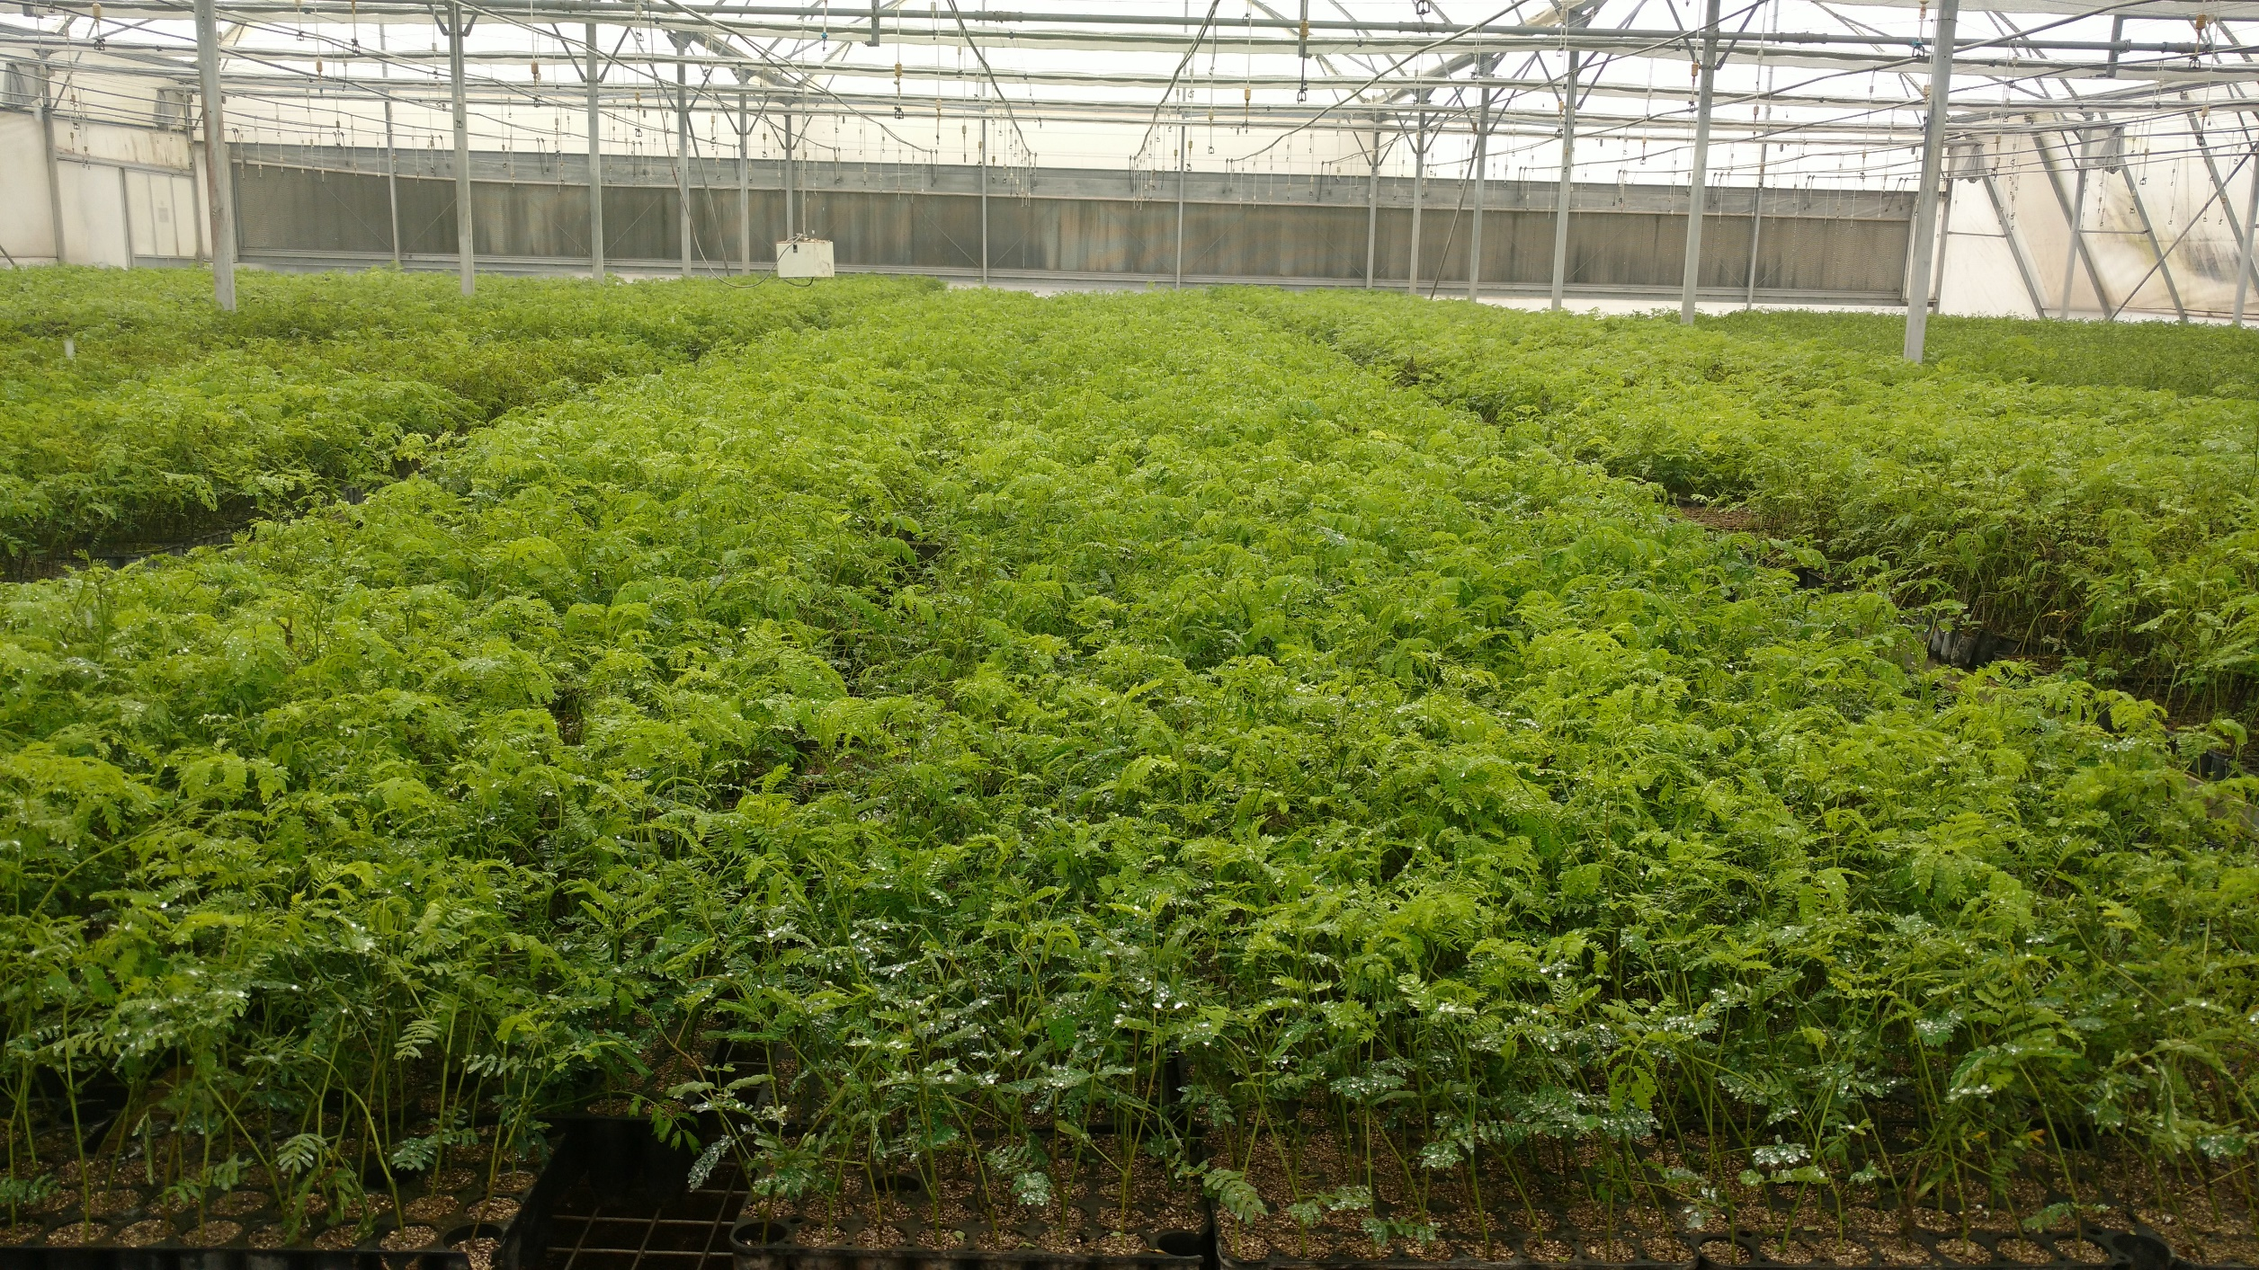
Cuttings are healthy in areas where misting is proper

